Slide 1
PowerPoint Accessibility

Slide 2
Slide Master
-Create layouts and themes instead of editing slides individually.
-Share changes across a theme, formatted correctly.
-View Tab → Slide Master

Slide 3
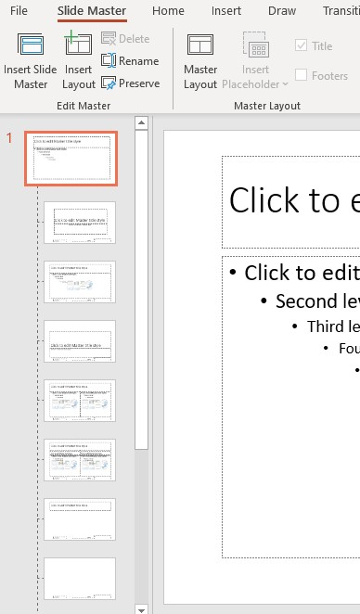
Slide Master

Slide 4
Reading Order
Visual reading order doesn’t define reading order to screen reader user
Manage with Selection Pane
Home tab → Arrange → Selection Pane

Slide 5
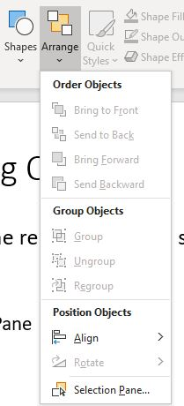
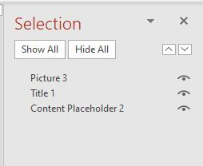
Reading Order

Slide 6
Color Contrast and Data

